Slide 1
Document scanner
Potyondi Zsombor

Slide 2
Task assignment
Komjáti Gábor – virtual paint
Lengyel Dániel – number plate detector
Potyondi Zsombor – document scanner

Slide 3
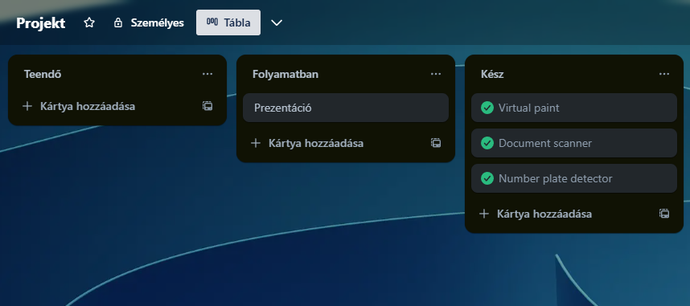
Project management tool
Trello

Slide 4
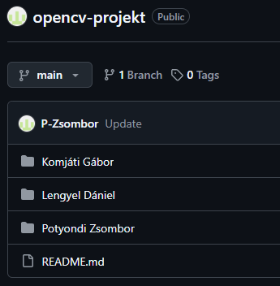
Programming tools
GitHub

Slide 5
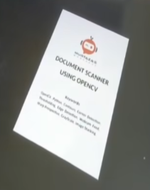
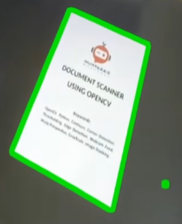
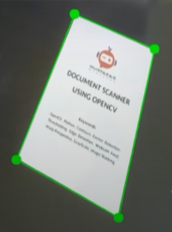
Code structure
Image reading:
Import libraries
Camera setup
Save camera image
Image processing:
Convert the image to grayscale
Blur the image
Highlight the edges
Contour detection:
Detect all contours
Filter square-shaped contours
Select the largest contour

Slide 6
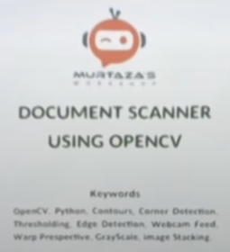
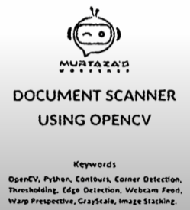
Code structure
Perspective correction:
Project the contour onto a rectangle
Crop and resize the image
Merging images:
Combine images
Displaying the different images
Continuous image processing:
Continuously read images from the camera
Process each image
The program runs until ‘q’ key is pressed

Slide 7
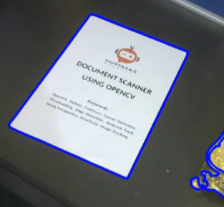
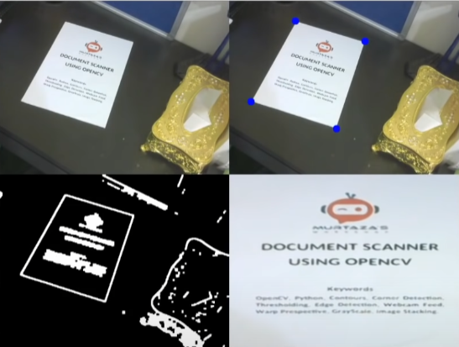
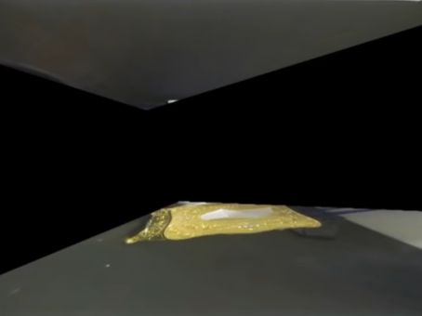
Code testing
Testing the code with a camera:

